Slide 1


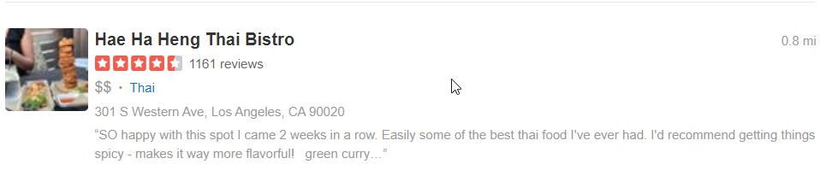
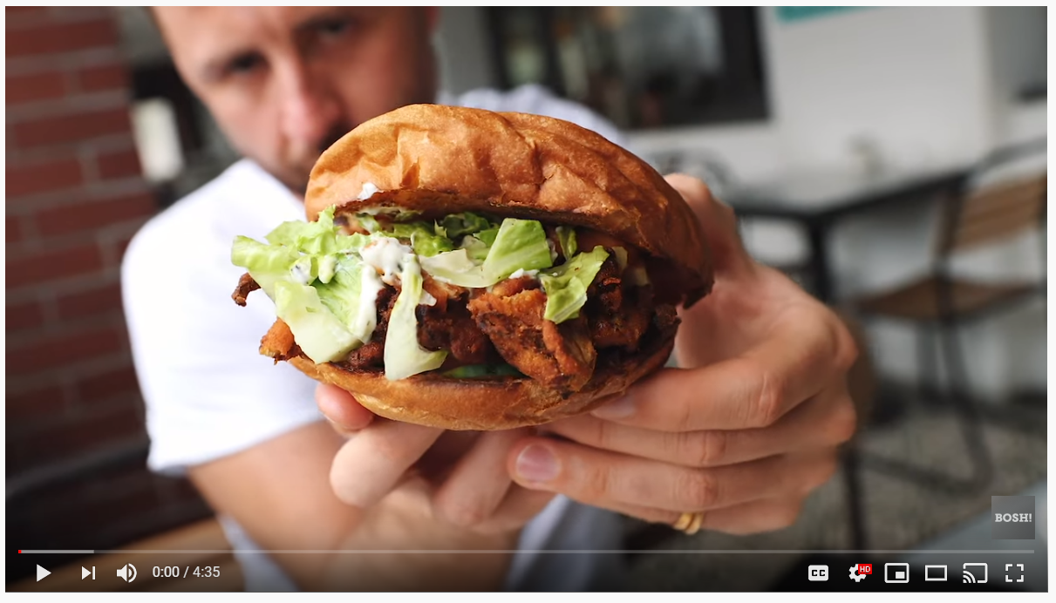
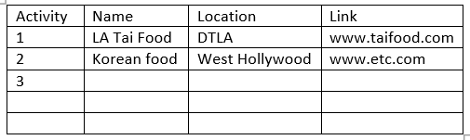
Savy Traveler
Savy Traveler
Savy Traveler
Youtube Top
Top Yelp
Youtube Top
Create your Itenerary
Create your Itenerary

Slide 2
Dark Mode (Maybe))
Savy Traveler
Top Yelp

Slide 3
Logo(Sticky(maybe))
Savy Traveler
Input: User input
ID= #City-Input
Description: Use this text for both api search terms
Top Yelp
Div: Empty by default and changed by Javascript/jQuery
ID= #YelpArea
Description: display top five search results from yelp

Slide 4
Savy Traveler
Youtube Top
Div: Empty by default and changed by Javascript/jQuery
ID= #YoutubeArea
Description: display Top search results from youtube API
Create your Itenerary

Slide 5
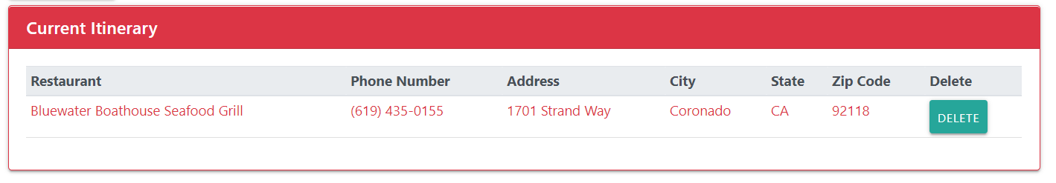
Savy Traveler
Youtube Top
Div: contains only the from layout without content
ID= #IteneraryArea
Description: allow user to input there information for the their trip and store it to local storage
Create your Itenerary

Slide 6

Savy Traveler

Slide 7
Savvy Traveler
Top Yelp
Top YouTube

Slide 8
Your Itinerary

Slide 9
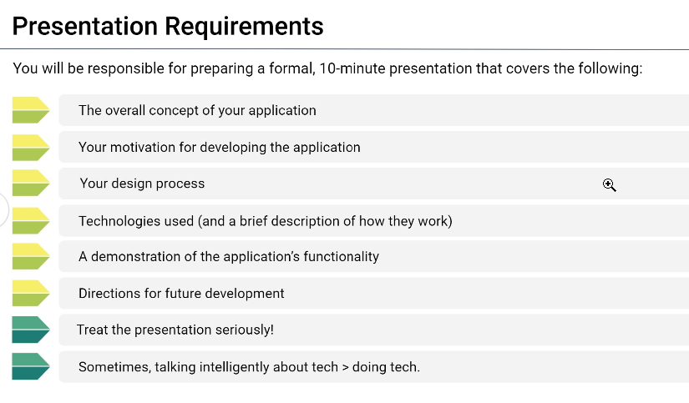

Slide 10
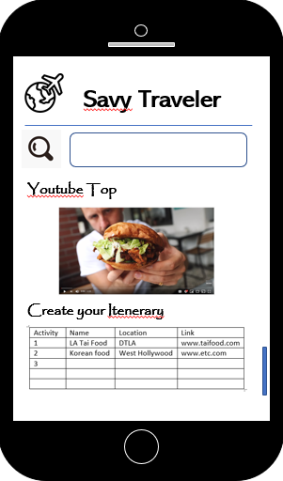




Project 1:
Using API’s to Help Travelers
Team Members:
Hazel Reyes
Sonia Pandit
Ana Pineda
Andres Ruiz

Slide 11


App Concept: Savvy Travels
Using API’s to Help Travelers
Target Audience: Travelers(Local and Non-Local)
Problem : When planning a trip, Travels want to visit and experience the best local food. This task can quickly get overwhelming with the endless possibilities. The traveler can experience “Analysis Paralysis”
Solution : Allow the travels to only browse the best reviews and rated restaurants and activities provided by the Yelp and Youtube APIs. Additionally the user can create their own itenarary based on the search results.
Motivation: Want to focus on the excitement of traveling.

Slide 12
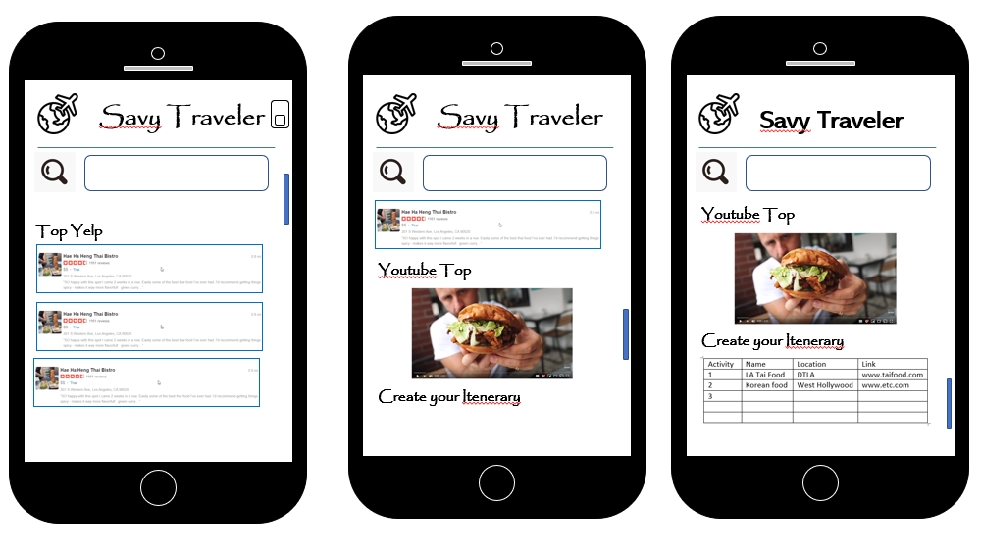
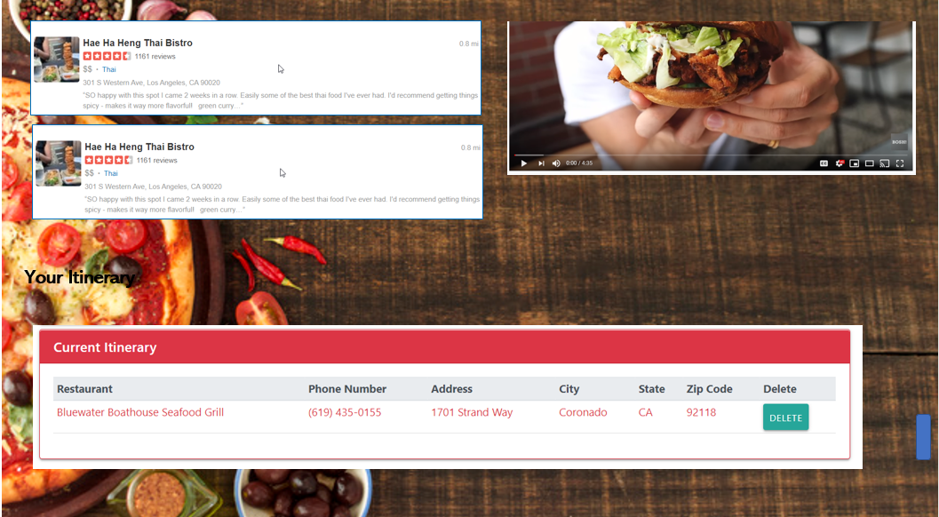
Design Process
Mobile
Desktop

Slide 13


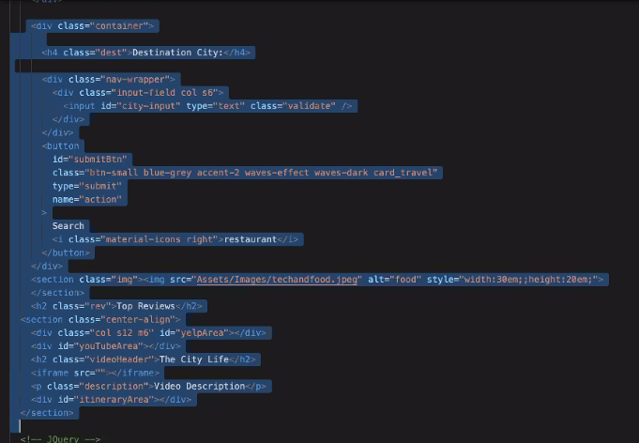
New Technologies
We used Materialize frame work to design the look of the application and make it responsive across all devices

Slide 14
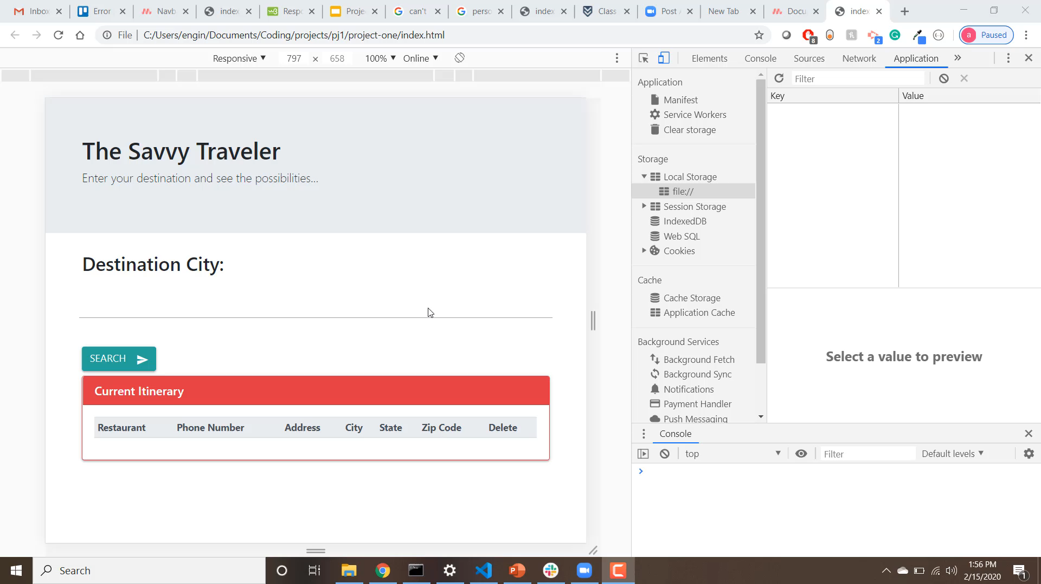
Demonstation

Slide 15
Challenges
1. Obtaining API response from Yelp API key. Needed to use Authorization Key within Object different from most APIs we have used
2. Logging users selection to itenarary both on the DOM and local Storage.
3.

